Slide 1
Intranet Quorum
For Constituent Services
Notes:
We are pleased to be here with you today to share some highlights of a transforming new technology that will benefit our processes and our citizens. Over the past several months I have been working with the Governors Operatons office to evaluate and decide upon a tool to address some of the workflow and reporting needs identified in the Governors office. The Governors office is probably not alone but for purposes of this enterprise wide pricelist the Governors office was the first area to focus on.. The team ultimately decided upon Lockheed Martin Desktop Solutions Intranet Quorum, or IQ for short.

Slide 2
IQ Solution Sample Implementations
  Federal Government
Executive Office of the President
Office of Management and Budget
Department of Justice / Attorney General
Department of Homeland Security
USAID / Inspector General
General Services Administration
Smithsonian
Department of Interior / BLM
United States House of Representatives
United States Senate
  State Government
Alabama Governor
Georgia Governor
Minnesota Governor
Mississippi Governor
Tennessee Governor
Washington Governor
Kansas Governor
West Virginia Governor
Michigan State Senate
New Mexico Governor
New Jersey Governor
Wisconsin Governor
Iowa Governor
Ohio Governor
Vermont Governor
Maryland Governor
Massachusetts Governor
Indiana Governor
Rhode Island Governor
Hawaii Governor
Local Government
New York City, NY
  City Council, Office of the Mayor
Washington DC
Fairfax County, Virginia
Seattle, Washington
Notes:
It is illustrative and confidence inspiring to see the many Governmental entities that IQ already has relationships with. It not surprising that some staff that have served in other governmental areas already have experience with IQ. Interestingly enough on one of our project status calls our trainer mentioned that she had just returned from IQ training at Representative Gabbards office , where she ran into Wendy Chervix – who previously served in Governor Abercrombies office. A small world, and interconnected communication systems like
IQ can make if feel even smaller.

Slide 3
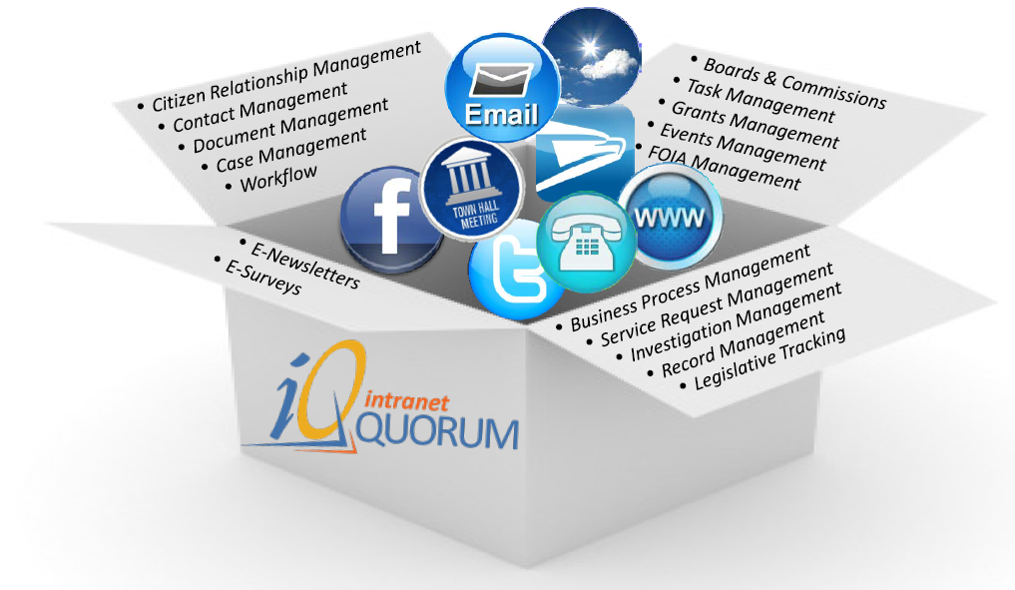
Out of the Box
Notes:
IQ is a very feature rich product. This slide highlights the many features of the product that are included “Out of the Box”. In the interest of time we plan to cover only a few of the
E-mail integration
Citizen Relationship Management
Contact Management
Dashboards

Slide 4
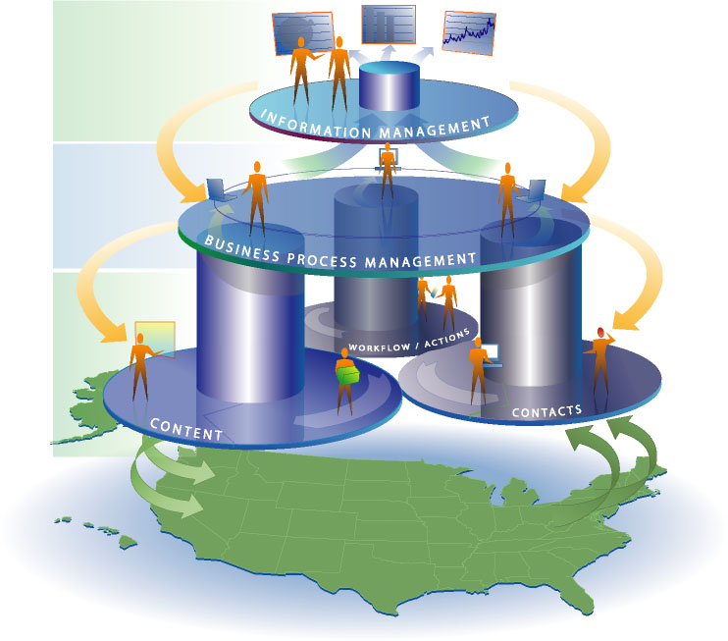
Understanding IQ
A comprehensive Information Management
Solution
To manage your Business Processes
By tracking your
  Content
  Contacts
  Workflow
Resulting in
Superior Citizen Service
A Comprehensive Approach that Delivers Superior Citizen Service
Notes:
based on a Commercial Off-The-Shelf (COTS) platform, with a wide range of capabilities such as correspondence, workflow, document management and scanning.
…an enterprise-strength, business process management solution, which enables agencies to be more responsive to their internal and external customers.
…a robust and Easy-to-Use browser interface, coupled with a powerful and highly-configurable workflow and database engine.
…a mission-critical communications tool used by customers with high public visibility.

Slide 5
Features
Web Forms integration
Communication by Affiliation
Communication to constituent preference
Constituent Interaction log
Dynamic Dashboard
Notes:
Constituent Services Forms
Form Name: Contact the Governor
Form Name: Schedule a Meeting with the Governor*
Form Name: Invite the Gov to an event*
Form Name: Request a Commendation or Special Message*
Form Name: Request a Proclamation*
Form Name: Flag Requests
Form Name:Hawai’i State Capitol Tour Request Form
Boards and Commissions
Forms:
Application:
Letter of recommendation
Aloha order of merit

Slide 6
Web Forms Integration
Constituent Services Forms
Contact the Governor
Schedule a Meeting with the Governor*
Invite the Gov to an event*
Request a Commendation or Special Message*
Request a Proclamation*
Flag Requests
State Capitol Tour Request Form
Boards and Commissions
Applications
Letter of recommendation
Aloha order of merit
Notes:
Hawaii.gov/gov Contact Us forms to Govs office
Trough the MAGIC of APIS
Become WORKFLOW
Can even integrate with non IQ users by parsing the subject line
Allowing Inter-departmental constiituent contact information.

Slide 7

Communication by Affiliation
Business Leaders
Crime
Native Hawaiian
Education
Legislator
Notes:
Affiliate names in database with person specific groups.
E.g. Legislators, Business Leaders, Native Hawaiian, Education, Crime etc.
A name can have multiple affiliations
Can you do this now?
Well…..NO
What is the benefit?
When sending out communications about Governor forums instead of culling folks from a master list , create a list specific to who we want.

Slide 8

Communication to constituent preference
Notes:
Identify the preferred means of communication by name.
Some persons prefer e-mail, while others prefer paper mail.
Can you do this now?
Well….NO
What is the benefit?
When sending out communications we could save postage, printing and collating time for those who prefer e-mail.

Slide 9
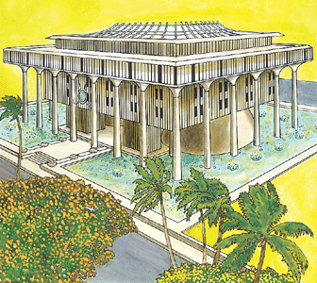
Constituent Interaction log
Notes:
Interactions are logged
Phones calls
E-mail
Letters
Visits
Interactions by name visible to many
Can you do this now?
Well…..NO
What is the benefit?
Customer focused response. Who helped them in the past. Conversation topics. We know you. We care about you.

Slide 10
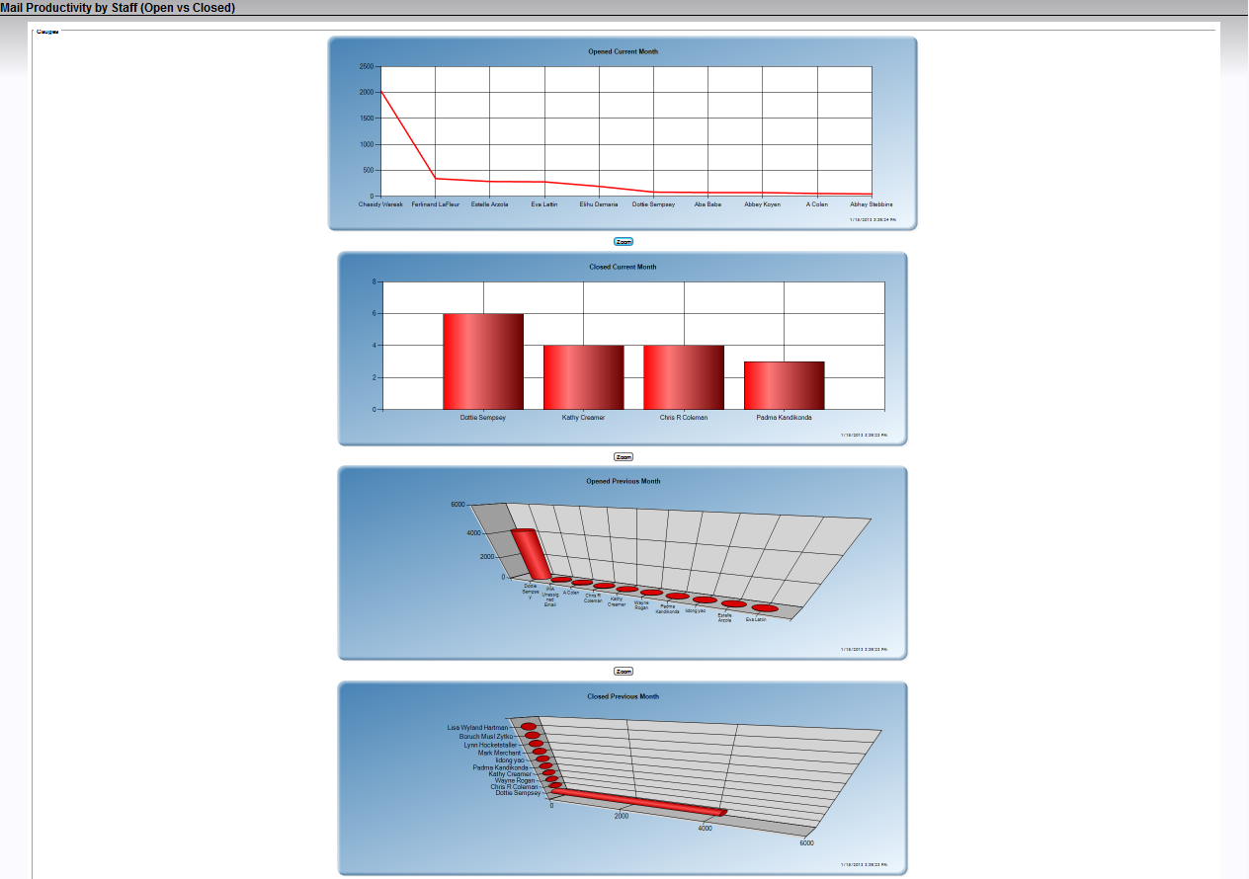
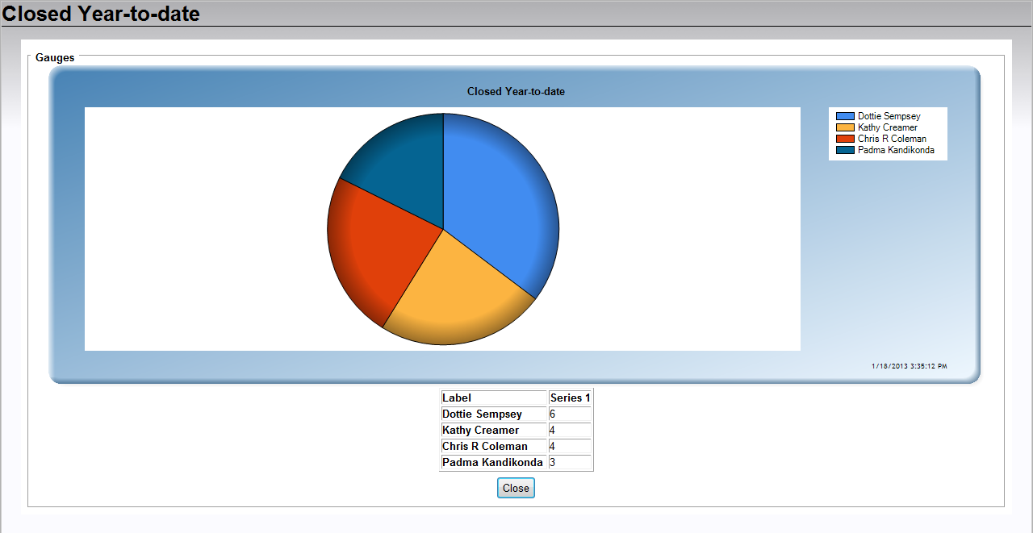
Dynamic Dashboard
Notes:
Tool includes a pre-built dashboard.
Variety of views
Incoming workload
Completed workload
Type of workload
Can you do this now?
Well…..NO
What is the benefit?
We would avoid manually tabulating performance data, creating spreadsheets and powerpoint presentations.

Slide 11
Lockheed Martin Desktop Solutions – helping to transform business processes in Hawaii
Intranet Quorum

