Slide 1
ITSC Report From The CIO: Network Program Update
25 September 2014

Slide 2
Presentation Agenda
Overview of Network Program Plan
Ongoing Implementation Efforts for Critical Projects
Inter-Data Center Network Connectivity
Expand Redundancy/Diversity (Network Hardening Project)
Modernize Infrastructure (Network Hardening Project)
Recently Completed/ Upcoming Activities
Questions

Slide 3
Overview of Network Program Plan Projects in the Network Program Plan address gaps and build toward the future state vision; They are prioritized and sequenced based on the following categories
Stabilize
Secure, Consolidate & Fortify
Establish a Foundation for the Future
Modernize & Expand
Category
Stabilize existing networks and mitigate immediate risks | Add reliability and robustness while simplifying and securing what HI has | Establish core network and security management services and competencies | Replace legacy equipment to increase bandwidth/scalability and expand the WAN to new locations
Add critical sites to fiber optic backbone (which includes Inter-Data Center Connectivity) Create separate (from INET) “State” fiber optic rings on each island Add redundancy/diversity to the State’s network Formalize operational processes and improve network monitoring and trend analysis Add network engineering function (e.g., resources) | Leverage state’s microwave network to fully diversify interisland connections Simplify and secure the Core IP networks across all departments Migrate departmental WAN connections to centralized MPLS and IPsec VPN solutions Secure and monitor departmental IT network devices Relocate Hemmeter network node | Deploy an enterprise trouble-ticketing system Create enterprise-level IT processes (change, incident, request, problem & etc.) Establish a service desk and a network/security operations center Develop enterprise network architecture/sourcing strategy Define network services and establish services levels and a chargeback/funding mechanism | Extend DWDM network to all locations Upgrade and Modernize DWDM infrastructure to support 10Gbps and greater backbone Modernize and upgrade MPLS routers to support higher speed backbone Extend fiber optic network to 30-40 additional sites Consolidate management of departmental local area networks (LAN’s)
Goal
1
3
2
Key Activities
Activities in Blue are Currently In Progress
Activities in Blue and Bold are Part of Critical Ongoing Projects

Slide 4
Inter-Data Center Connectivity Introduction to Inter-Data Center Connectivity Design
1
The solution for Inter-Data Center network connections has been designed to meet all data center requirements, i.e., high availability, high capacity, and high scalability (including the requirements of the Government Private Cloud Project)
The solution includes three major components:
1: Connectivity through Dense Wavelength Division Multiplexing (DWDM) over Oceanic fiber
2: Connectivity through Carrier Services
3: Redundant Network Equipment
The advantage of using these three major solution components is explained on the next slide

Slide 5
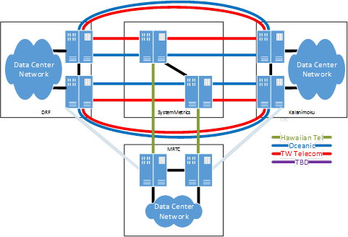
Inter-Data Center Connectivity Inter-Data Center Connectivity Must be High Capacity; and Scalable, Reliable and Available
1
1. The State is leveraging DWDM over Oceanic fiber to enable cost effective provisioning of large amounts of inter-data center bandwidth (Solution benefit is increased network Capacity and Scalability)
2. The State is also using high-bandwidth carrier backup circuits to help ensure high availability of connectivity (Solution benefit is a more Reliable and Available network)
3. The State is installing redundant equipment across network layers to help ensure greater network uptime (Solution benefit is a more Reliable and Available network)

Slide 6
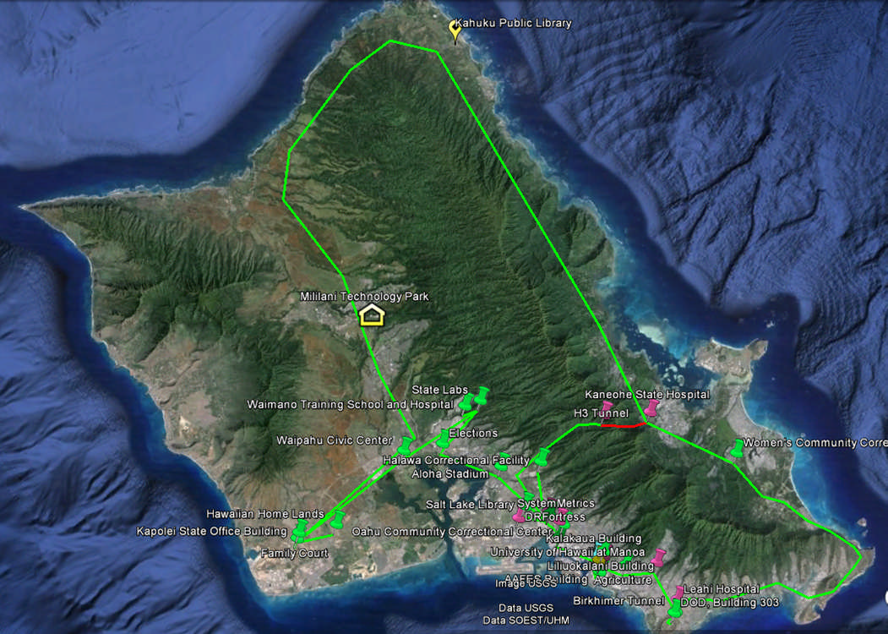
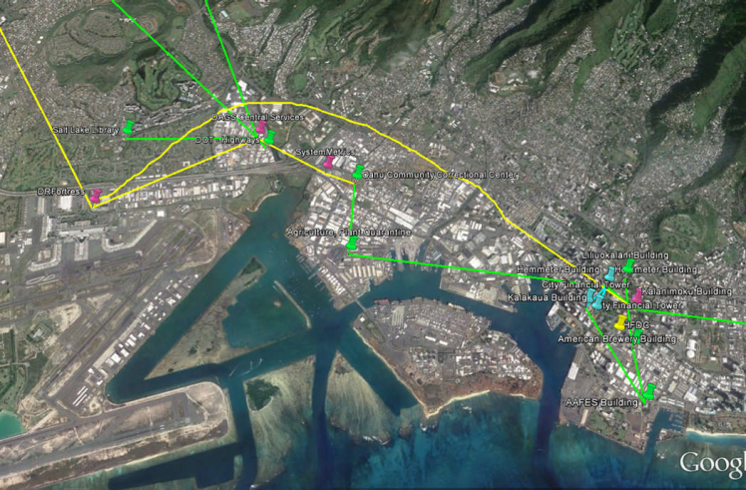
Expand Redundancy/Diversity (Network Hardening) Identify Network Weaknesses and Add Redundancy and Diversity to Mitigate Risk
2
The State is coordinating with telco providers to understand their physical path diversity to assess weaknesses in the network architecture, identify potential mitigation options, and support selection of the best mitigation approach. The benefit of implementing risk mitigation solutions will be a reduction in the risk/impact of mass or extended outages
Mitigation approaches include requesting fiber strands from DOT in order to complete an INET sub-ring
Mitigation approaches include requesting physically diverse network paths when adding carrier circuits
Mitigation approaches include leveraging different vendors for interisland backup circuits to gain access to different interisland cables and also to introduce carrier diversity

Slide 7
Modernize Infrastructure (Network Hardening) Upgrade and Modernize Network Infrastructure, including DWDM Equipment
3
One objective of the Network Hardening project is to identify network sites that are suitable for inclusion in a future high availability ring
Key project activities to meet this objective include:
Conducting network node site visits on Oahu to identify sites with access to backup power, sites that are easily accessible for after hours emergency maintenance, any site-specific issues with the potential for impacting network availability
Leveraging information gathered during site visits and additional critical information (e.g., available fiber path diversity to sites), evaluate network node upgrade requirements, complete upgrade planning, and a phased upgrade implementation (upgrades will be phased over several years)
Another objective is to replace unsupported DWDM equipment on Oahu and to execute upgrades strategically to improve equipment sparing capability
Key project activities to meet this objective include:
Conducting an analysis of alternatives to select the new DWDM vendor/solution to replace the unsupported Sorrento DWDM equipment;
Conducting Sorrento hardware sparing requirements analysis (including physical inventory of DWDM cards) to help evaluate/adjust Sorrento equipment sparing strategy and to help drive sequencing of future network node site upgrades

Slide 8
Recently Completed/ Upcoming Activities
Inter-Data Center Connectivity
Network Hardening Project
Recently Completed Activities
Upgraded data center network infrastructure at Kalanimoku from 1Gbps to 10 and 40Gbps Refined project plan for installing network infrastructure at DR Fortress Ordered and received majority of equipment required for network infrastructure at DR Fortress Began install and test network infrastructure at DR Fortress Supervised installation of carrier circuits at DR Fortress
Upcoming Activities
Order and receive remaining equipment required for network infrastructure at DR Fortress Complete install and test network infrastructure at DR Fortress Supervise remaining installation of carrier circuits at DR Fortress
Recently Completed Activities
Defined project scope and high-level project plan for the “Network Hardening Project” Conducted network node site visits for majority of INET sites Assessed strengths and weaknesses across network sites and completed a Sorrento sparing analysis Requested solution (i.e., suggested Bill of Materials) and pricing information from DWDM vendors and completed alternatives analysis for DWDM vendor/ solution selection
Upcoming Activities
Finalize DWDM analysis and complete vendor/ solution selection Coordinate with telco vendors to assess physical path diversity Complete detailed planning for site upgrades

Slide 9
Questions?
If you have additional questions or would like to provide recommendations, reach out to David Fujimoto, Amy Peckinpaugh, or Mark Lennon

